Slide 1

Beer Recommendation System
Jeffrey Oller

Slide 2
Data Source
BeerAdvocate.com
Via Kaggle - https://www.kaggle.com/datasets/rdoume/beerreviews

Slide 3
Data:
Info():
After transforming: 1,56,1037 rows
# Column Non-Null Count Dtype
--- ------ -------------- -----
0 brewery_id 1586614 non-null int64
1 brewery_name 1586599 non-null object
2 review_time 1586614 non-null int64
3 review_overall 1586614 non-null float64
4 review_aroma 1586614 non-null float64
5 review_appearance 1586614 non-null float64
6 review_profilename 1586266 non-null object
7 beer_style 1586614 non-null object
8 review_palate 1586614 non-null float64
9 review_taste 1586614 non-null float64
10 beer_name 1586614 non-null object
11 beer_abv 1518829 non-null float64
12 beer_beerid 1586614 non-null int64
dtypes: float64(6), int64(3), object(4)
memory usage: 157.4+ MB
 | review_profilename | beer_beerid | review_overall
0 | stcules | 47986 | 1.5
1 | stcules | 48213 | 3.0
2 | stcules | 48215 | 3.0
3 | stcules | 47969 | 3.0
4 | johnmichaelsen | 64883 | 4.0
5 | oline73 | 52159 | 3.0
6 | Reidrover | 52159 | 3.5
7 | alpinebryant | 52159 | 3.0
8 | LordAdmNelson | 52159 | 4.0
9 | augustgarage | 52159 | 4.5
10 | fodeeoz | 436 | 3.0

Slide 4
Model:
Surpr!se
Funk SVD – Collaborative model

Slide 5
Model Performance:
RMSE of 60% on testing data

Slide 6
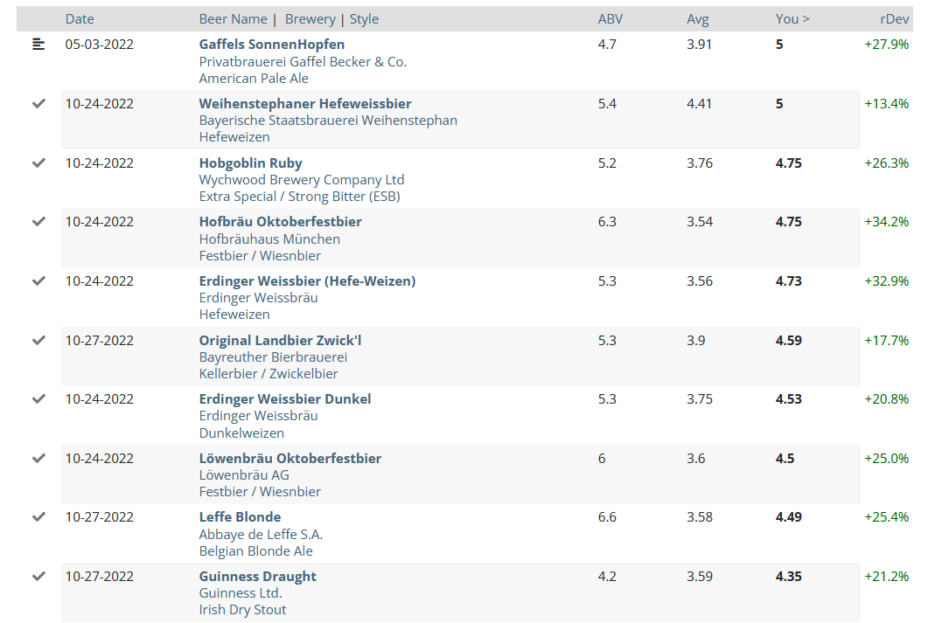
My BeerAdvocate Ratings:

Slide 7
Results:
Subjective measure of how appropriate the recommendations are
 | Total | Active | Retired
Good | 29 | 10 | 19
Fair | 18 | 2 | 16
Bad | 2 | 1 | 1

Slide 8
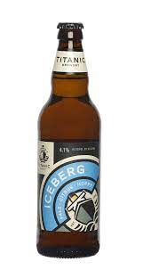
Beers to Try:

Slide 9
Limitations:
Recommender has bias for rare beers
Doesn’t take into account features of the beer itself

Slide 10
Future Improvements:
Hybrid model – Tensorflow
Give popular beers more weight in the recommendation

